Slide 1

CMPE 275 - CartPool
Team : Spartan Sharks
( Term Project 3 )
Aswin Prasad
Shubhangi Yadav
Sruthi Duvvuri
Vidita Daga

Slide 2
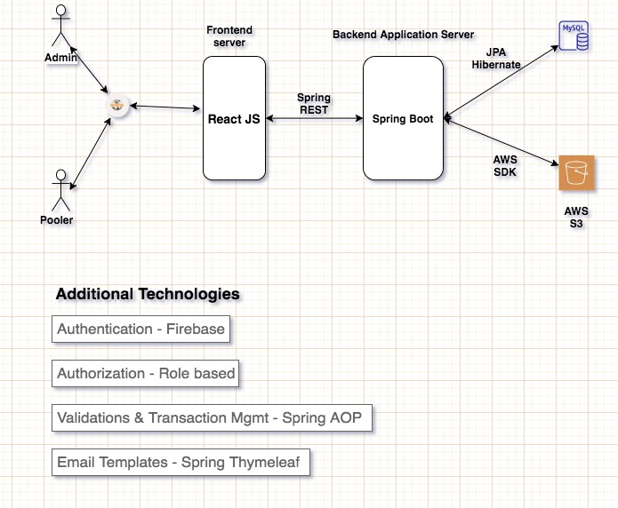
High Level Design
Principles & Patterns leveraged:
1) Dependency Injection
-- Autowired beans
2) Aspect Oriented Programming
-- Validations
-- Configurations
-- String trimming
3) ORM
-- JPA Hibernate
4) MVC
-- Controller, Service, DAO layer
5) Transaction Management
-- Spring Transactions

Slide 3
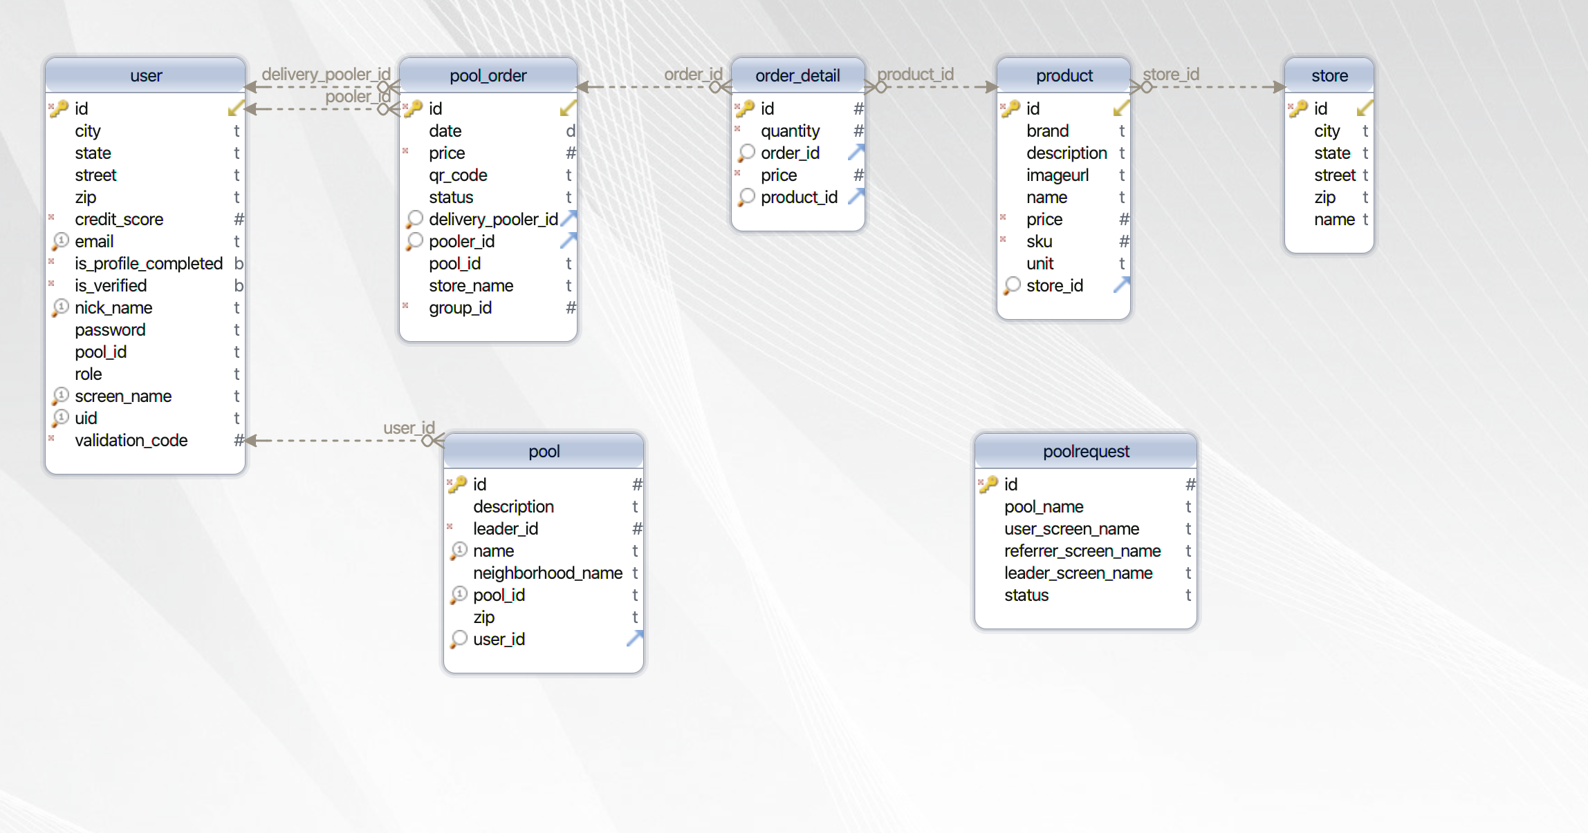
Database Design

Slide 4
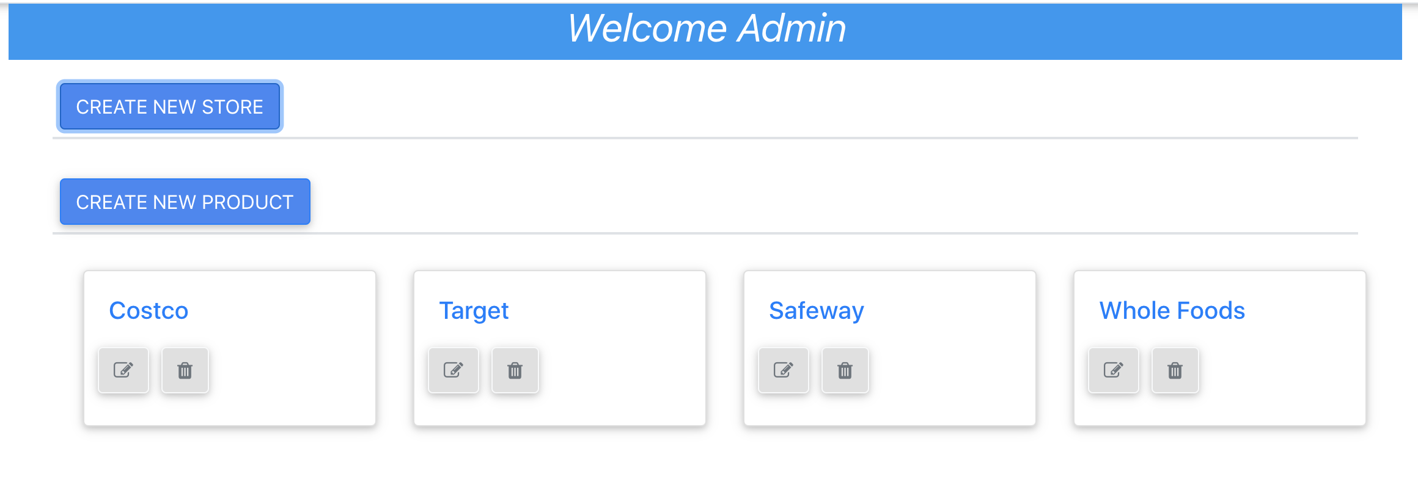
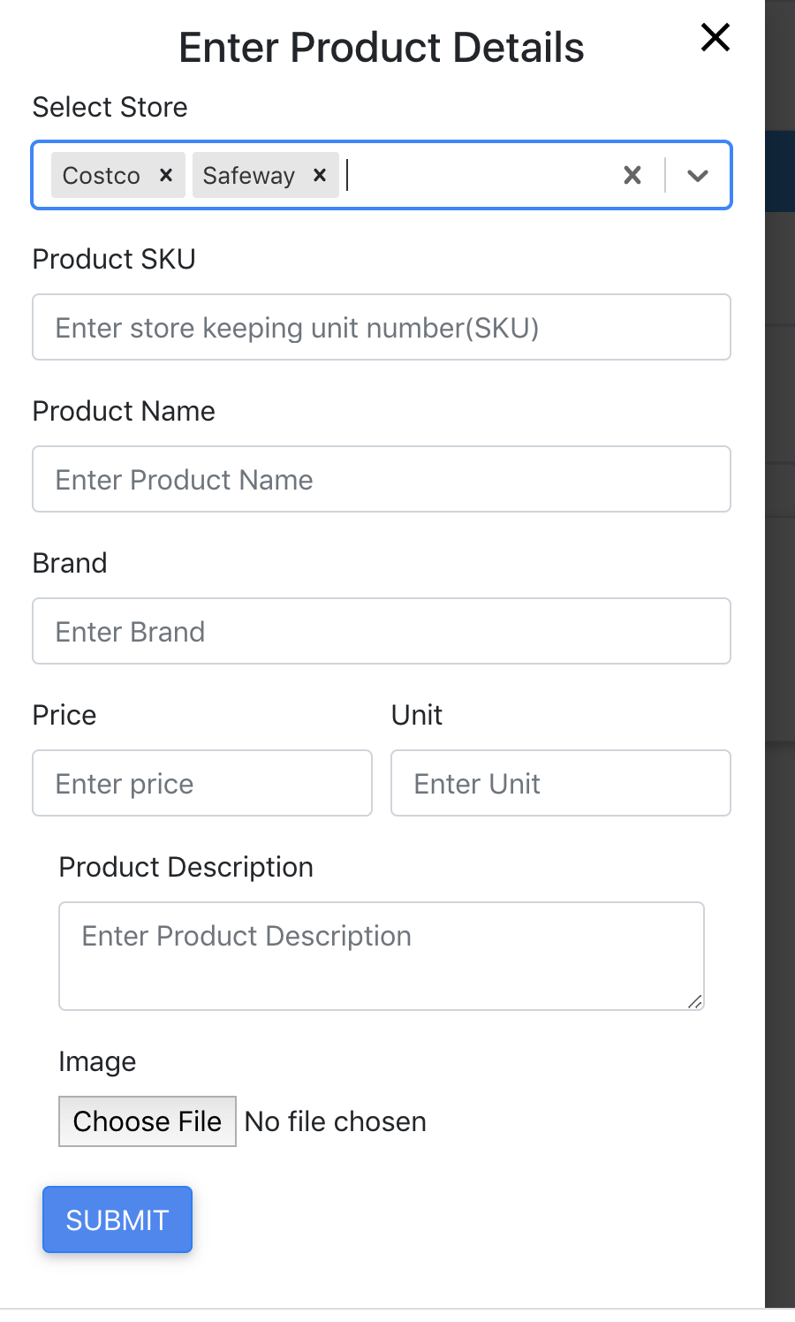
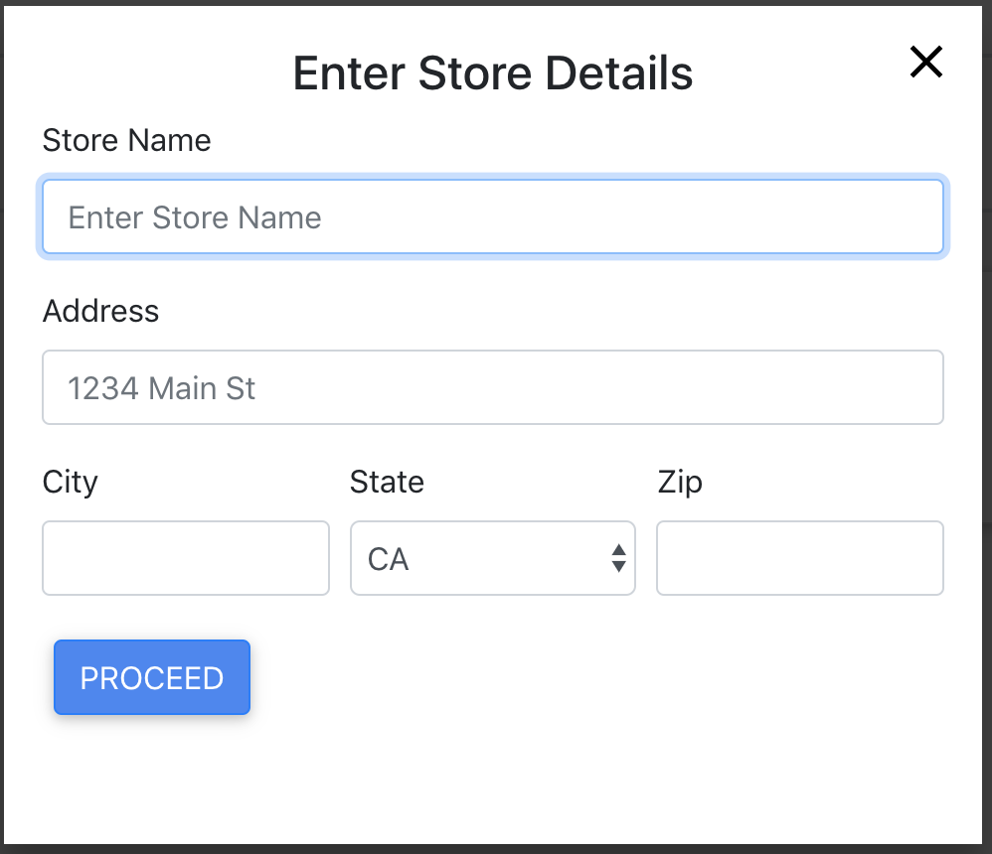
Major Features - Admin
Home Page
Create Product
Create Store

Slide 5
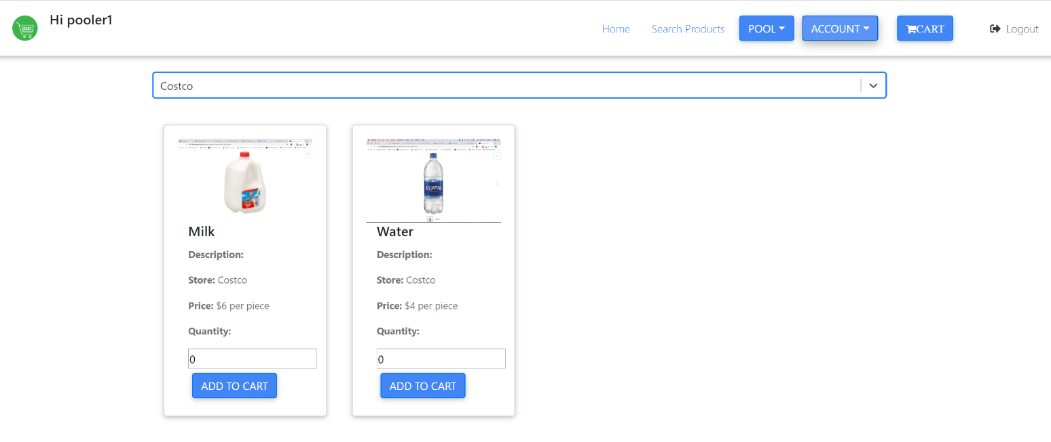
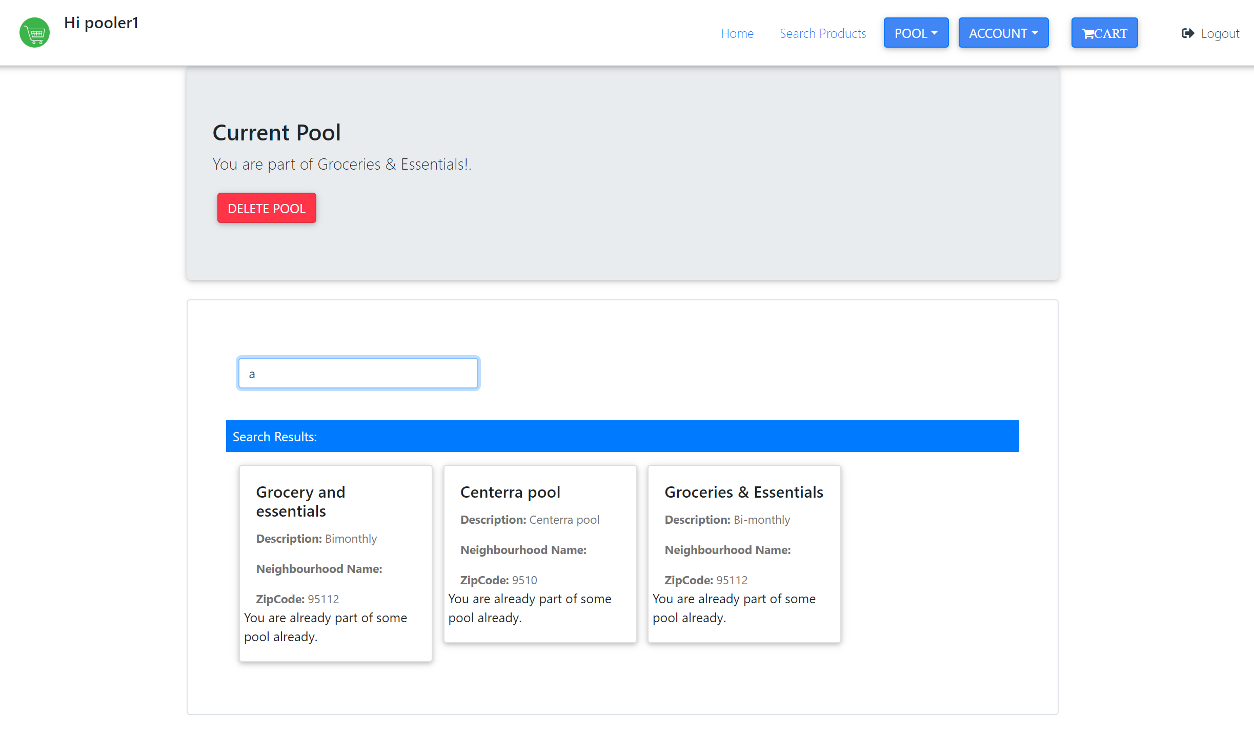
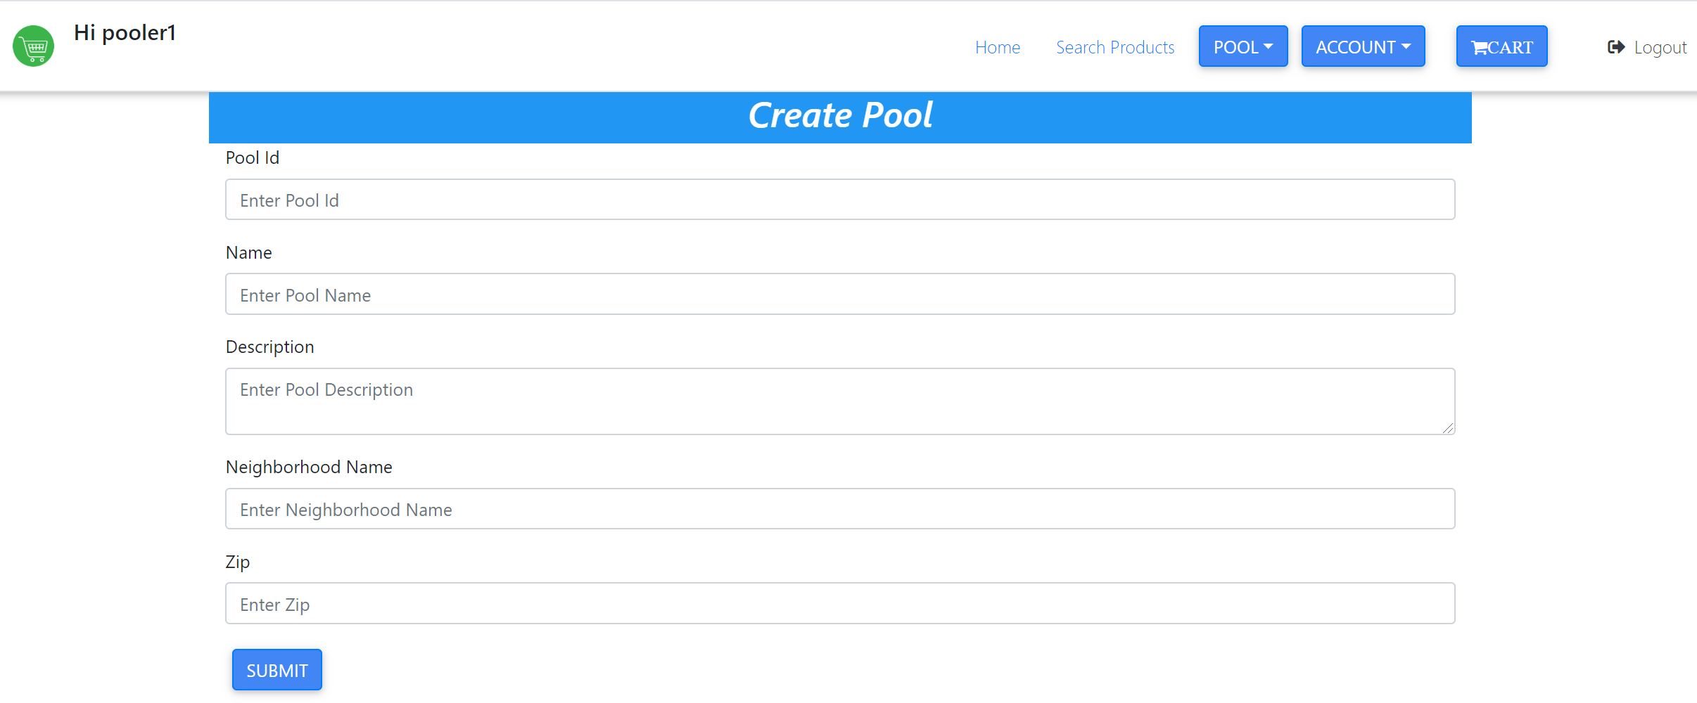
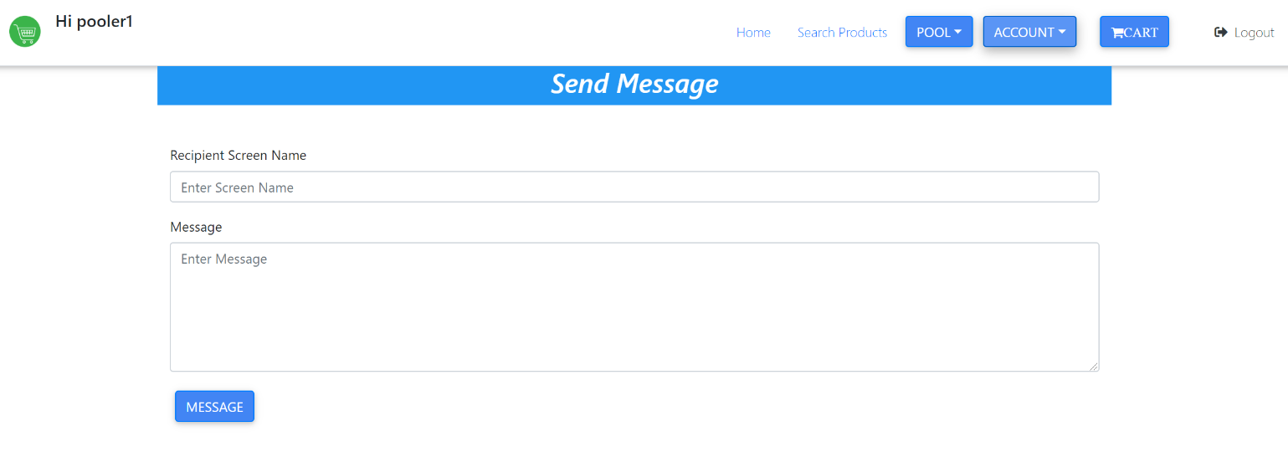
Major Features - Pool, Pooler, Products, Message

Slide 6
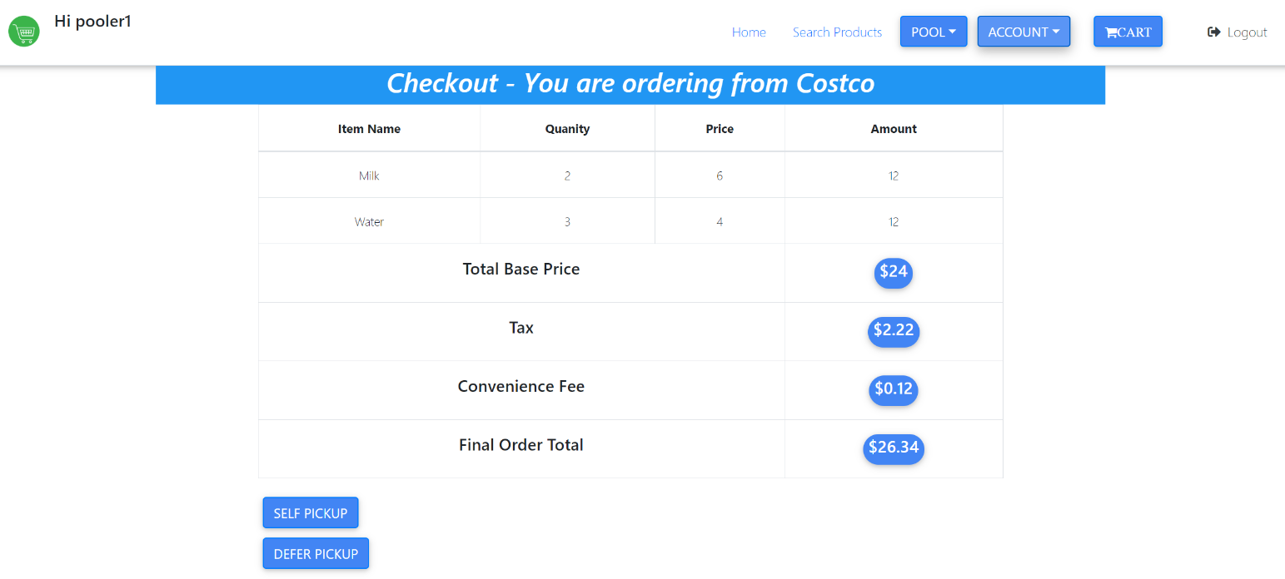
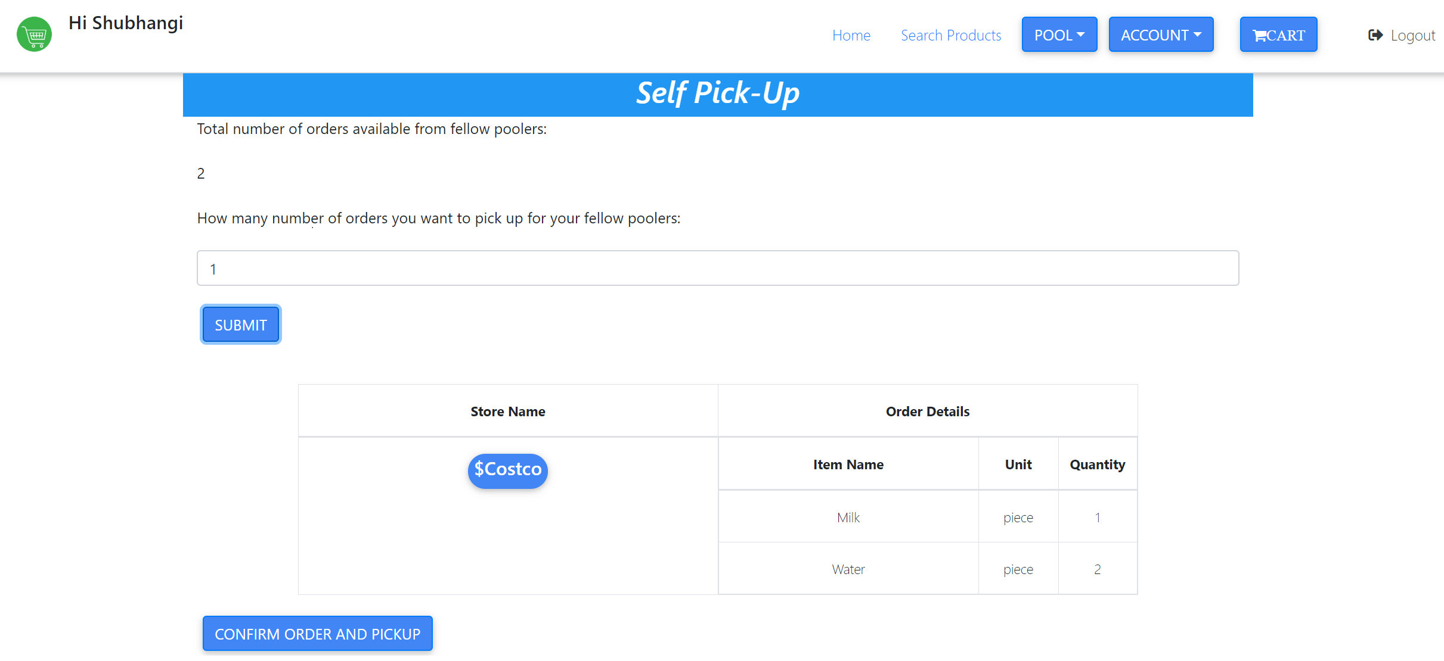
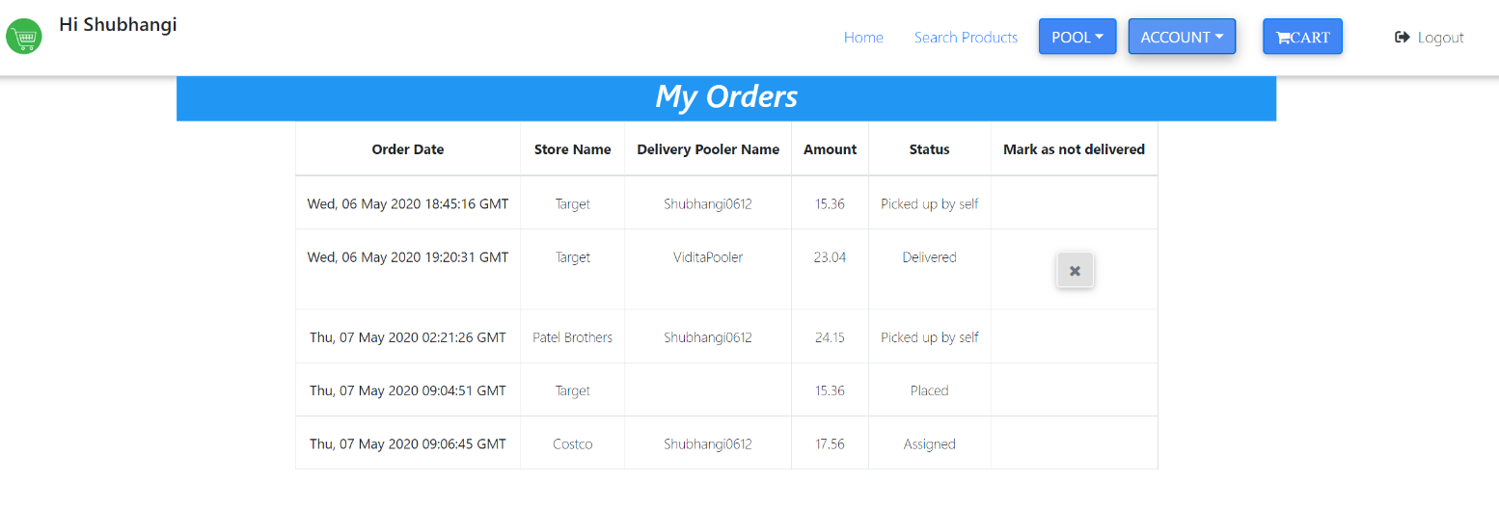
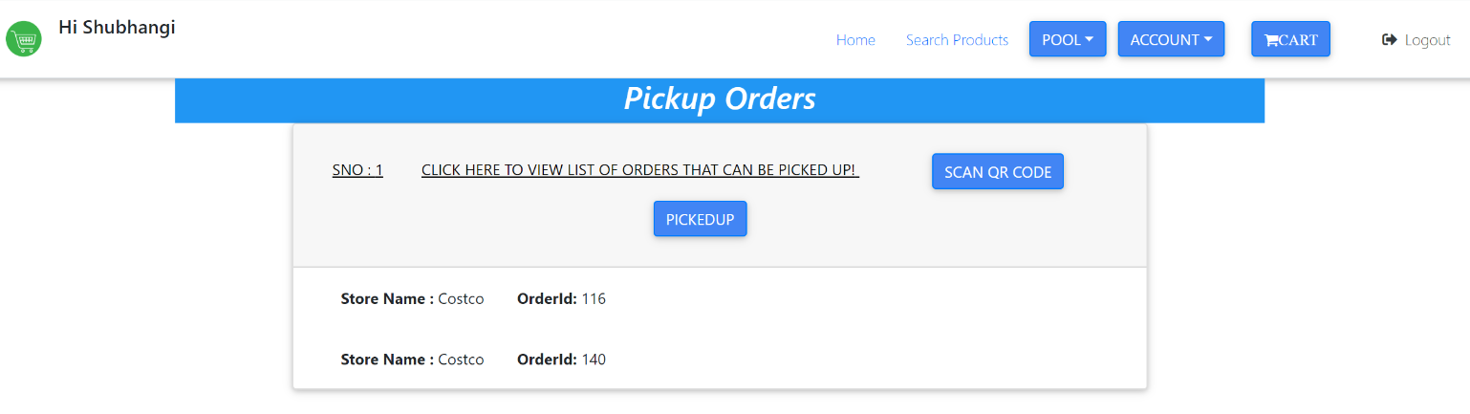
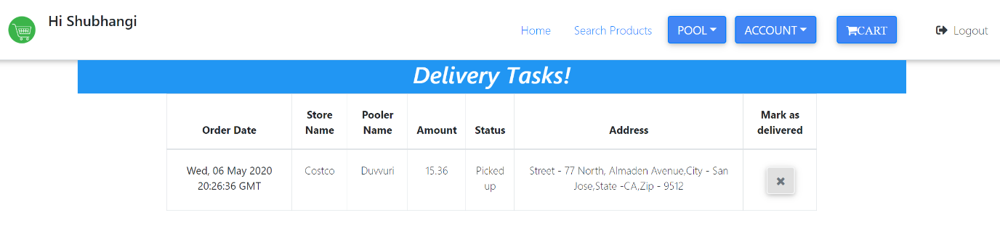
Major Features - Checkout, orders, pickups and delivery

